Slide 1

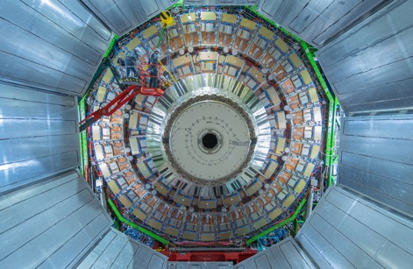
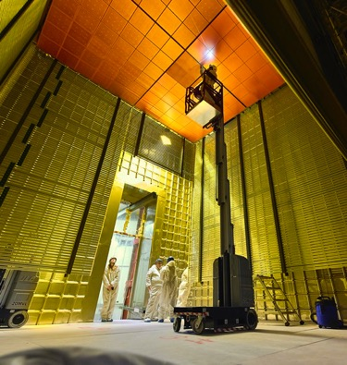
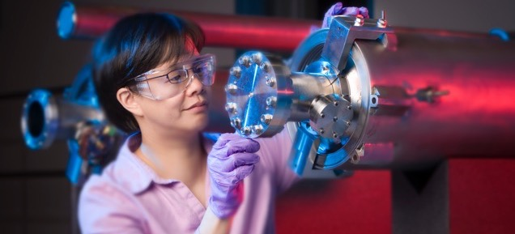
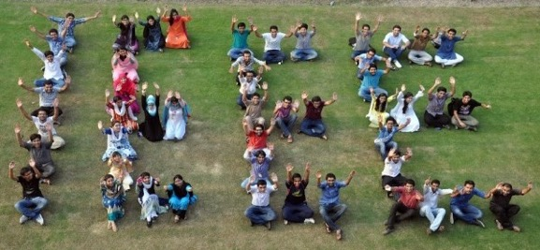
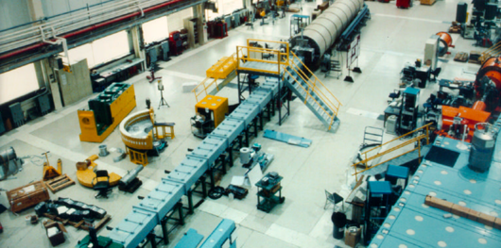
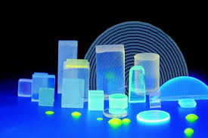
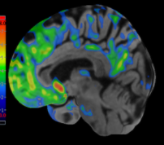

IEEE and IEEE Nuclear and Plasma Sciences Society

Slide 2

The Fuel of IEEE: Mission & Vision
IEEE is where forward-thinking technology professionals come together—in the spirit of collaboration—to discover the next technological innovation, develop international standards, and form communities to share research, education, and humanitarian goals.
Our Mission
The core purpose of IEEE is to foster technological innovation and excellence for the benefit of humanity.
Our Vision
IEEE will be essential to the global technical community and to technical professionals everywhere; and be universally recognized for the contributions of technology and of technical professionals in improving global conditions.
Proprietary
Notes:
IEEE and its members stretch far beyond just engineering, IEEE wants to look at the big picture and solve global problems.
What does that mean?
It means that IEEE wants to:
Expand and enable diverse communities to help individuals from around the world to share, collaborate, network, debate, and engage with one another.
Provide technically vital forums for the discussion, development, and dissemination of authoritative knowledge related to traditional, emerging and disruptive technologies.
Lead humanitarian efforts around the world to use technology to solve the world’s most challenging problems.
Leverage IEEE’s technology-related insight to provide governments, NGOs and other organizations, and the public with innovative and practical recommendations to address public policy issues.
To achieve that, we have business solutions that are vital to both companies and their employees.

Slide 3



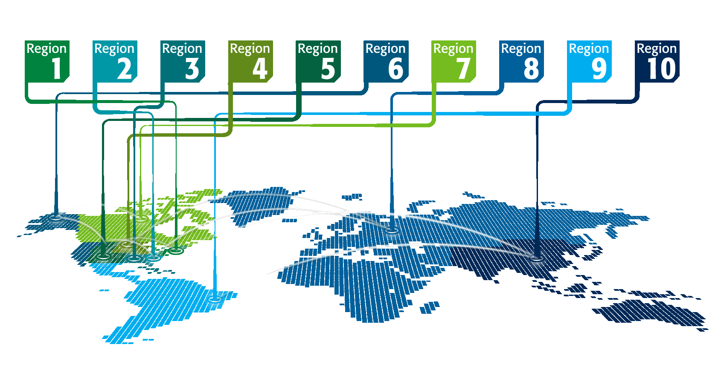

IEEE at a Glance
IEEE has…
Over 400,000 members
in more than 160 countries,
more than 60 percent of whom are
from outside the United States
More than 107,000 Student members
342 Sections in ten geographic
Regions worldwide
2,562 Chapters that unite local members with similar technical interests
3,485 Student Branches at colleges and universities in over 100 countries
2,877 Student Branch Chapters of IEEE technical Societies
580 affinity groups and growing
All figures stated above are current as of 04/2021.

Slide 4
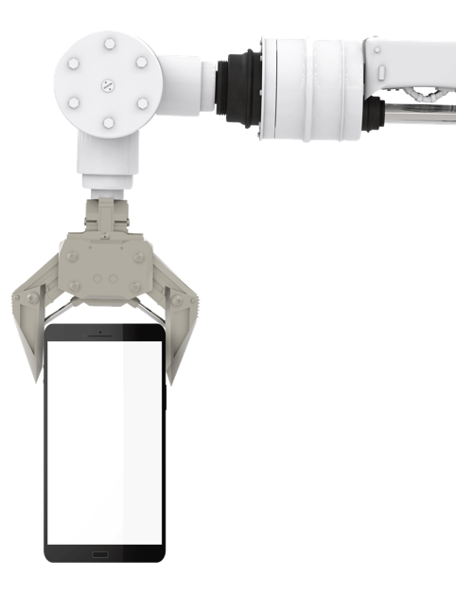

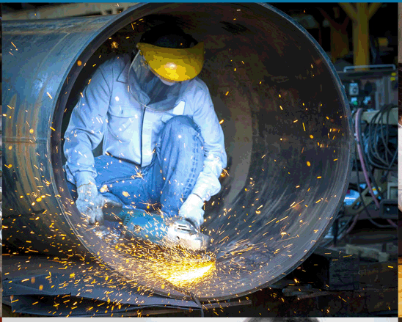

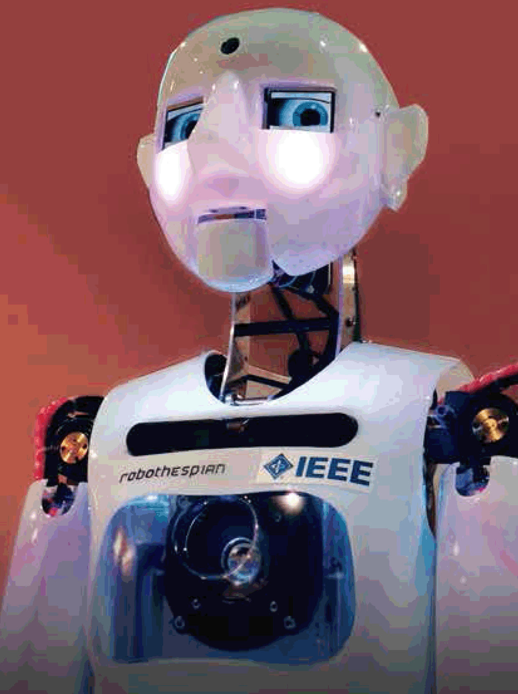
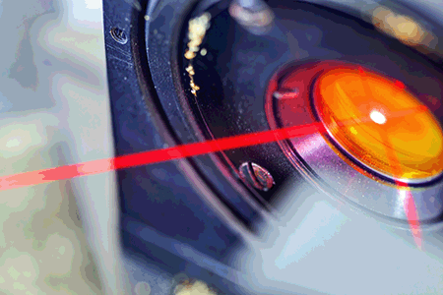
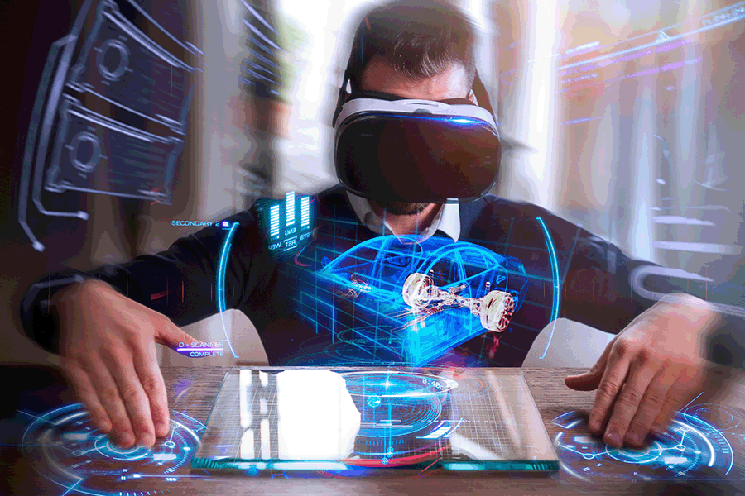

IEEE at a Glance
IEEE…
Has 39 technical Societies and seven Technical Councils representing the wide range of IEEE technical interests
Has more than 6 million documents in the IEEE Xplore® digital library, with more than 15 million downloads each month
Has an active portfolio of nearly 1,200 standards and more than 900 projects
under development
Publishes approximately 200 transactions, journals, and magazines
Sponsors more than 2,000 conferences in 96 countries annually
All figures stated above are current as of 04/2021.

Slide 5
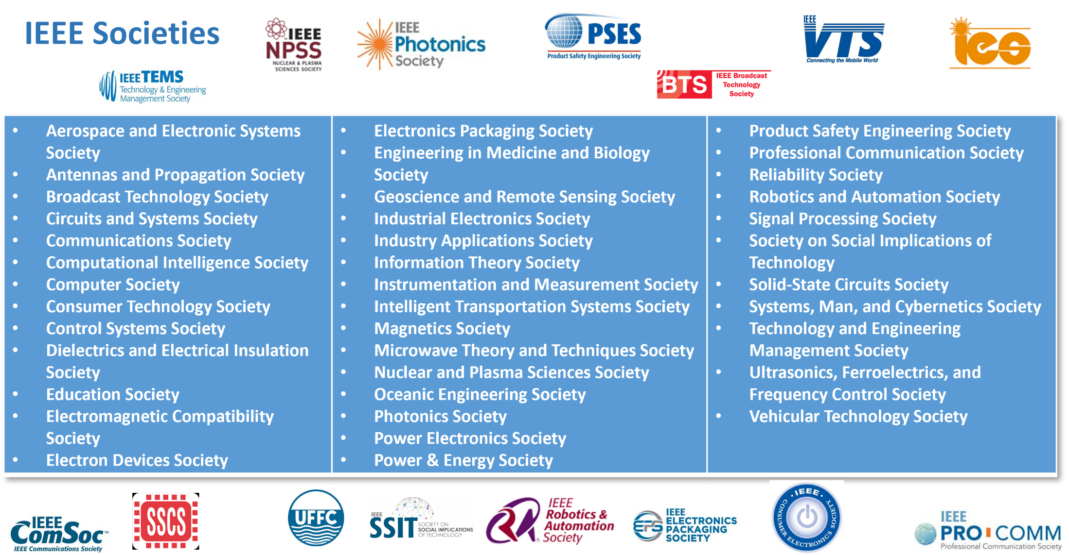
NPSS in IEEE
* As of October 2022

Slide 6
Technical Expertise that is Broad and Deep
IEEE provides thought leadership and resources for the global tech community.
Aerospace & Defense
Biomedical Engineering
Broadcasting
Circuits
Communications
Computer Science
Control and Automation
Cyber Security
Electronics
Environment
Industrial systems
Information Technology
Internet of Things
Life Sciences
Nanotechnology
Optics
Power and Energy
Robotics and AI
Semiconductors
Smart Cities
Smart Grid
Sustainable Energy
Transportation and Vehicles
And more…
Notes:
IEEE facilitates the cross-pollination of ideas, giving people access to ideas developed in other disciplines.

Slide 7








Top Organizations Innovate with IEEE
Whenever technology happens, IEEE is there.
All Top 5
Communications Equipment Companies Worldwide
15 of Top 20
Aerospace and Defense Companies Worldwide
8 of Top 10
Telecommunication Companies Worldwide
7 of Top 10
Automobile Manufacturers Worldwide
99 of Top 100
Engineering and Technology Universities Worldwide
9 of Top 10
Computer Hardware Companies Worldwide
27 of Top 30
Semiconductor Companies Worldwide
All Top 100
Engineering Universities in the United States
Notes:
The top companies and universities rely on IEEE information through IEEE Xplore. IEEE influences major industries—and is at the forefront of today’s technology.
Today, IEEE is expanding in many ways: people, communities, nations, collaborative settings, intellectual properties, and more.

Slide 8



2023 Technical Activities Strategic Framework
Tools and Platforms
Next Gen Tools & Processes
Resource Center
DataPort
ICX
TechNav
PRAC Tool
New Tech
Graduating initiatives
  Future Networks
  Blockchain
  Digital Reality
New Initiatives
  Wireless Power Transfer
  Metaverse
Continuing initiatives
  Quantum
  Telepresence
  Smart LED Lighting
  Low Earth Orbit Satellite
Society New Tech Efforts
New Audiences
New virtual audiences
Entrepreneurs
Industry
Young Professionals
Students
  Scholarships
  Travel Grants
  Mentoring
Women in Engineering
D&I
New Content
Increased Stds
TechEthics
Humanitarian
Academies (with EA)
Climate Change
  SmartAg
New Delivery
Video Content
OA & R&P
Chinese Publications
Podcasts
Post-COVID Events
Educational Programs
Roadmaps
Build Technology
Communities
Managing
Foundational
and Ongoing
Business Effectively
Sustained Impact of COVID
Assure Content Quality
Address misconduct
Address Data Privacy
Deliver Data Analytics
Grow and Relook at Membership

Slide 9
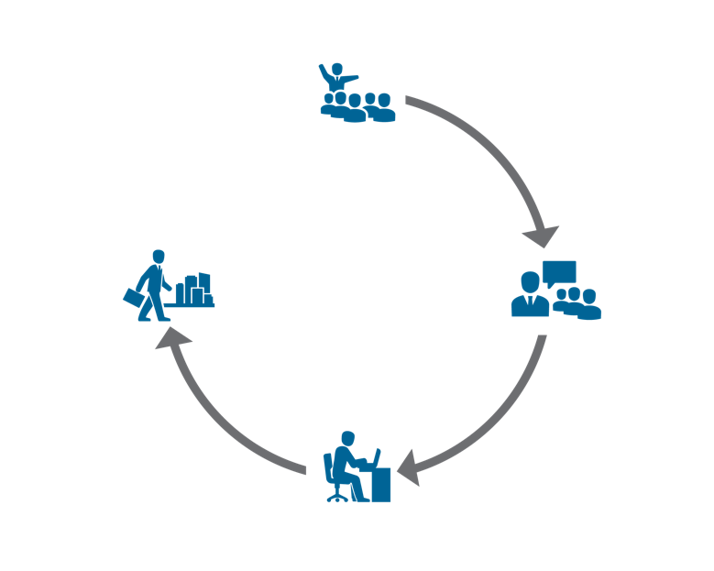









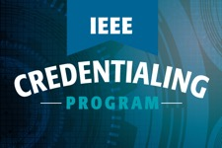
IEEE Educational Activities Programs Our Role in the Cycle of Lifelong Learning
PRE-UNIVERSITY
ADVANCED AND
MID-CAREER
PROFESSIONALS
UNIVERSITY
Continuing Education Products including
YOUNG PROFESSIONALS
Soliciting input from societies!
Joint TAB/EAB Ad Hoc on Continuing Education

Slide 10






















Forward looking - IEEE Future Directions –
2023 IEEE Future Directions Coverage
Exited from Future Directions
5G and Beyond Testbed
Wireless Power Technologies**
Metaverse**
TechNav AI
X
*
*
*
Plus AI/ML
X
Becomes a Council in 2024
*Last year (2022) in Future Directions
**New in 2023
ieee.org/futuredirections
10

Slide 11

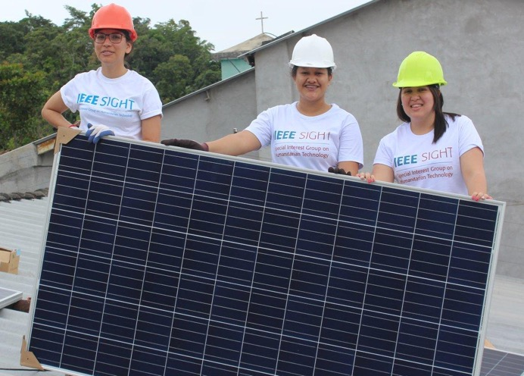
IEEE Humanitarian Technologies Board (HTB)
Inspiring, connecting, and empowering IEEE volunteers
IEEE HTB provides leadership and resources that inspire and enable IEEE volunteers around the world to carry out and support impactful humanitarian technology and sustainable development activities at the local level.
IEEE HTB’s work focuses on:
Raising awareness – IEEE HTB engages in outreach efforts so that existing and potential IEEE members know how they can use their technical skills for social good.
Providing training – Educational materials and opportunities allow humanitarian technology and sustainable development activities participants to obtain necessary skills.
Supporting IEEE humanitarian technology and sustainable development activities – from 2016-2020 over US$2.66M was awarded in funding to 329 projects and events.
Strengthening the sustainable development community through collaborations within, and beyond, IEEE.
Learn more: htb.ieee.org

Slide 12

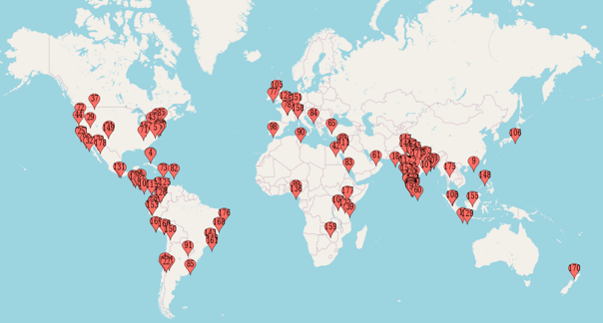
IEEE Special Interest Group on Humanitarian Technology (SIGHT)
Connecting a global network of technically-trained individuals
SIGHT is a popular feet-on-the-ground initiative operating within IEEE HTB. SIGHT’s global network of volunteers' partner with underserved communities and local organizations to leverage technology for sustainable development.
There are 17,500+ individual SIGHT members in 119 countries— approximately 75% are students or graduate students.
SIGHT encourages members to form groups to:
  learn about sustainable development
  build relationships within their local communities
  implement projects that utilize technology to tackle key challenges the community is facing
Since SIGHT’s inception in 2011, over 180 SIGHT Groups have been established in 53 countries.
“We gained knowledge, improved technical skills, expanded our network, and made bonds with the community.
We encourage anyone willing to help implement humanitarian technology projects—we guarantee you will have
a great experience.”
—SIGHT Project participant from El Salvador
Learn more: sight.ieee.org

Slide 13

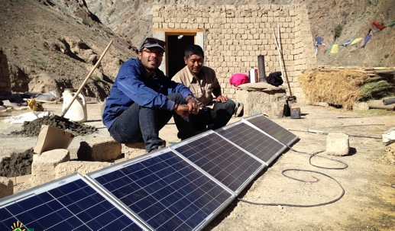
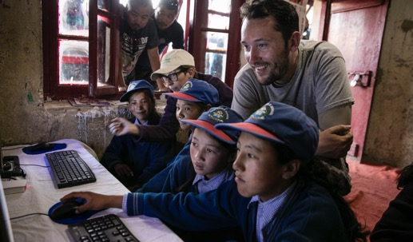
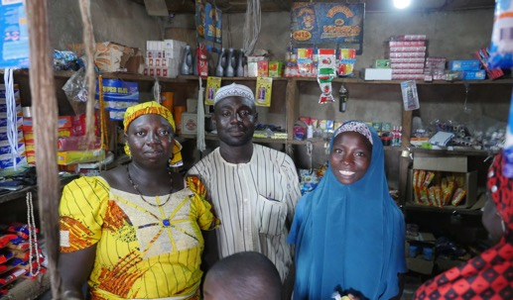
IEEE Smart Village
IEEE Smart Village is lighting up homes, businesses, and global classrooms—and empowering local economies using three pillars:
ENERGY
Provides renewable-energy solutions and necessary funding to local entrepreneurs to build electricity companies, assists the partners in establishing a sustainable business plan, and delivers ongoing training.
EDUCATION
Two complementary components crucial to helping stimulate sustainable community prosperity.
Development Practice graduate certificate in humanitarian engineering
Community Entrepreneurship vocational training to deploy, maintain, and franchise an IEEE Smart Village seed-funded micro-utility.
ENTREPRENEURSHIP
Our philosophy of empowering local entrepreneurs is unique in this philanthropic endeavor. These business owners have personally invested in the success of their community. The pride in accomplishments achieved together furthers the economic growth of the area.
Learn more: smartvillage.ieee.org

Slide 14
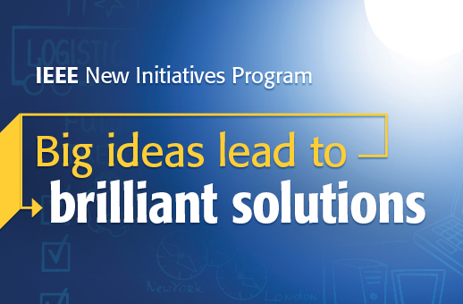
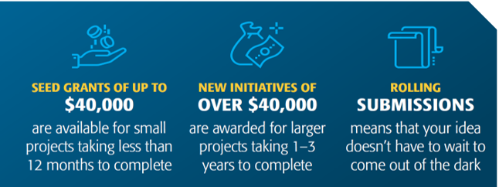
IEEE New Initiatives Program
Big ideas lead to brilliant solutions
The New Initiatives program supports potential new IEEE initiatives, services, or products which could have lasting impact on IEEE:
Increasing IEEE's connectivity to the industry
Engaging and recruiting members
Creating innovative education opportunities
Increasing the visibility of IEEE and its relevance to different communities
Learn more: ieee.org/initiatives

Slide 15



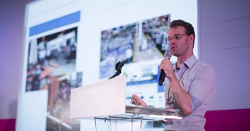



Benefits of Membership
IEEE members stay current in the technology profession, connect with peers, and invest in career advancement.
Access vital technical information and research
Connect to the profession with valuable networking opportunities
Explore education resources and career development tools
Participate in local activities
Receive discounts on IEEE products and other services
Find ways to contribute to the community
Plus, get tailored benefits by joining an IEEE Society.
Learn more: ieee.org/join

Slide 16

Nuclear and Plasma Sciences Society (NPSS)

Slide 17
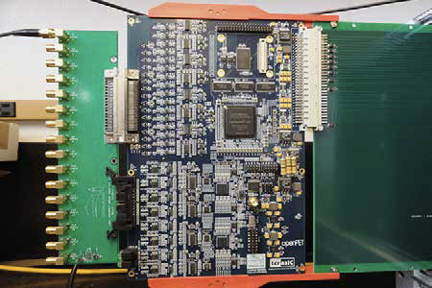
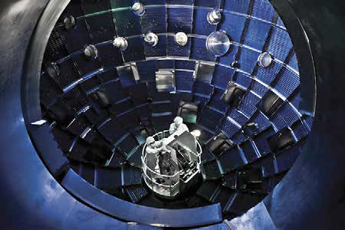
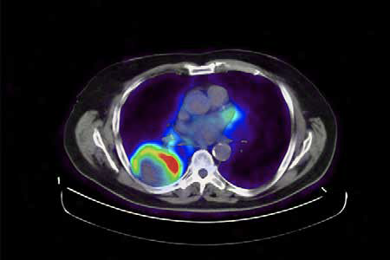
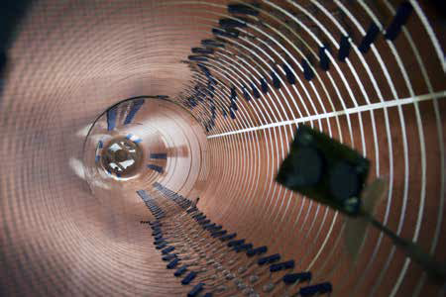
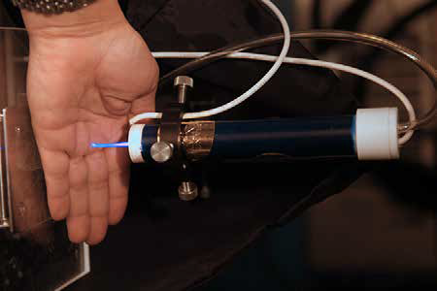

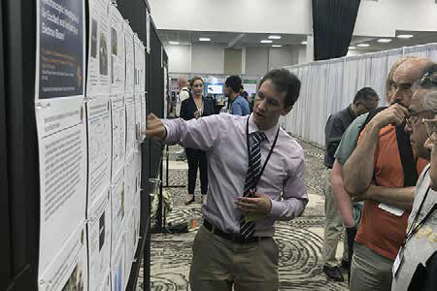
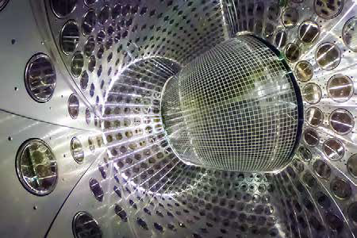
Technical Areas in NPSS (8)
Computer Applications in Nuclear and Plasma Science (CANPS)
Computer systems, HW and SW aspects of data acquisition/analysis/storage/control in all NPSS disciplines
Fusion Technology Committee (FTC)
Science and technology to harness the power of the stars
Nuclear Medical & Imaging Sciences Committee (NMISC)
We advance nuclear medicine science through technological innovation
Particle Accelerator Science and Technology Committee (PAST)
Design, construct, & operate particle accelerators supporting research, industrial, & societal needs
Plasma Science and Applications Committee (PSAC)
Explores the science & technology associated with the collective interactions of electromagnetic fields and plasma
Pulsed Power Science and Technology Committee (PPST)
We produce high peak power to achieve unique sources and study fundamental physics
Radiation Effects Committee (REC)
We strive to advance, apply, and disseminate radiation effects research
Radiation Instrumentation Technical Committee (RITC)
Radiation Instrumentation A to Z

Slide 18
NPSS Mission- Strategic goals
Mission Statement
To provide opportunities for scientific exchange and career development and to promote a diverse and inclusive community of nuclear and plasma scientists and engineers.
Strategic Goals
Our broad strategic goals are:
To offer high quality technical conferences, community engagement, networking and outreach activities that meet the educational, research and professional development needs of our community.
To provide publications that are among the highest ranked journals in their respective fields.
To encourage growth of a diverse and inclusive community of volunteers, with a particular focus on internationalization and increasing the participation and leadership opportunities for under-represented groups.
To undertake impactful development activities that foster technological innovation, with priority given to activities related to the NPSS fields of interest, and to sustainability for recurring activities.
Initiatives are an important tool to operationalize strategic goals.

Slide 19
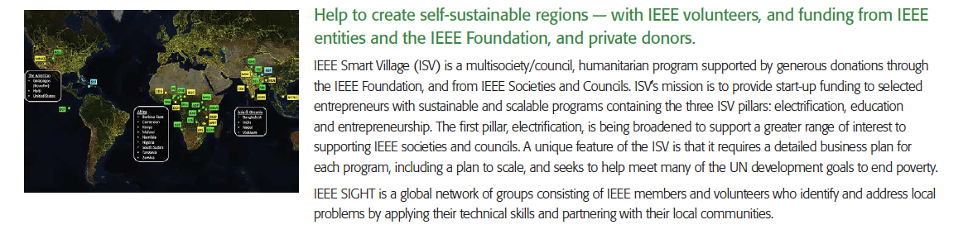
NPSS Initiatives (1):
Humanitarian Outreach

Slide 20
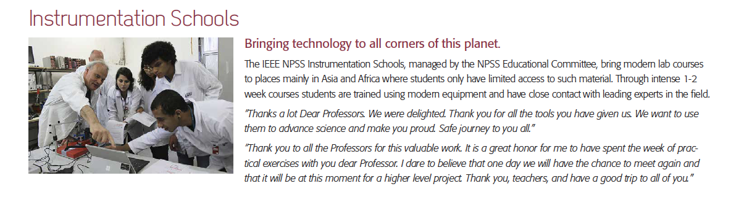
NPSS Initiatives (2):
Schools
Schools held recently

Slide 21
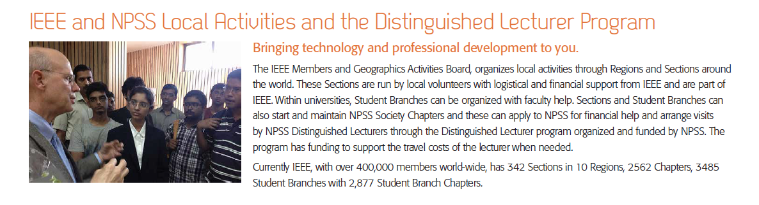
NPSS Initiatives (3):
IEEE and NPSS Local Activities and the Distinguished Lecturer Program

Slide 22
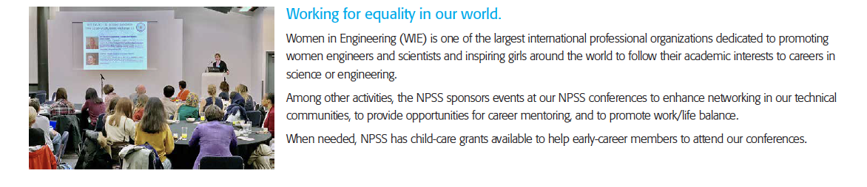
NPSS Initiatives (4):
Diversity and Inclusion

Slide 23
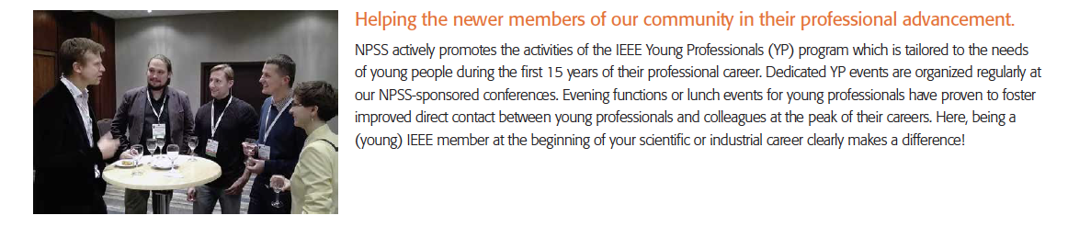
NPSS Initiatives (5):
Young Professionals

Slide 24
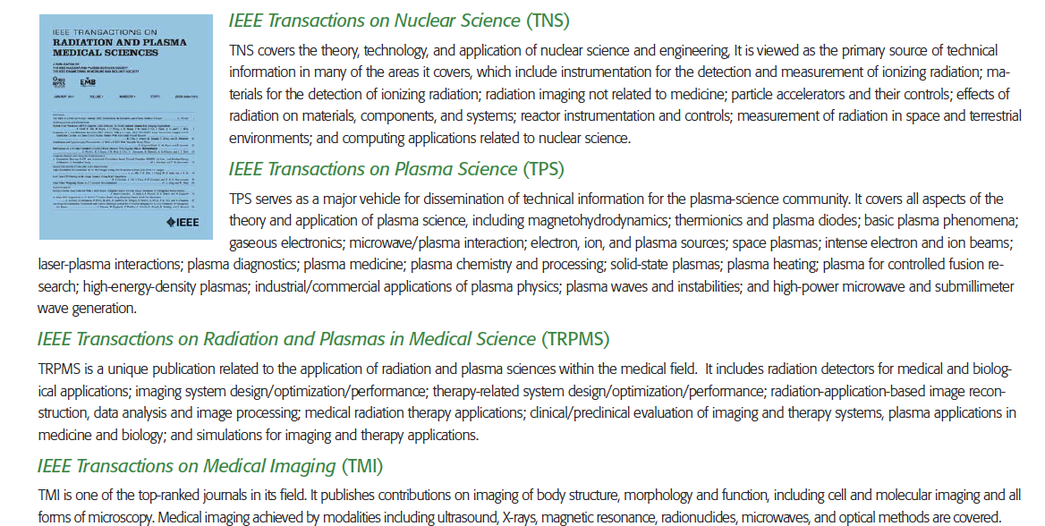
Our Journals — High-quality, Refereed Archival Publications

Slide 25
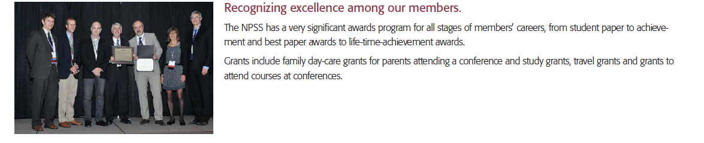
Grants, Awards and Recognition

Slide 26
Opportunities for Volunteering
Help organizing conferences
Review papers
Bring in new ideas
Become part of a committee
What would you do better if you would be our next president?
Participate in summer schools, Women-in-Engineering (WIE) events
This will look nice on your CV!

Slide 27

μVolunteering http://uv.ieee.org

Slide 28
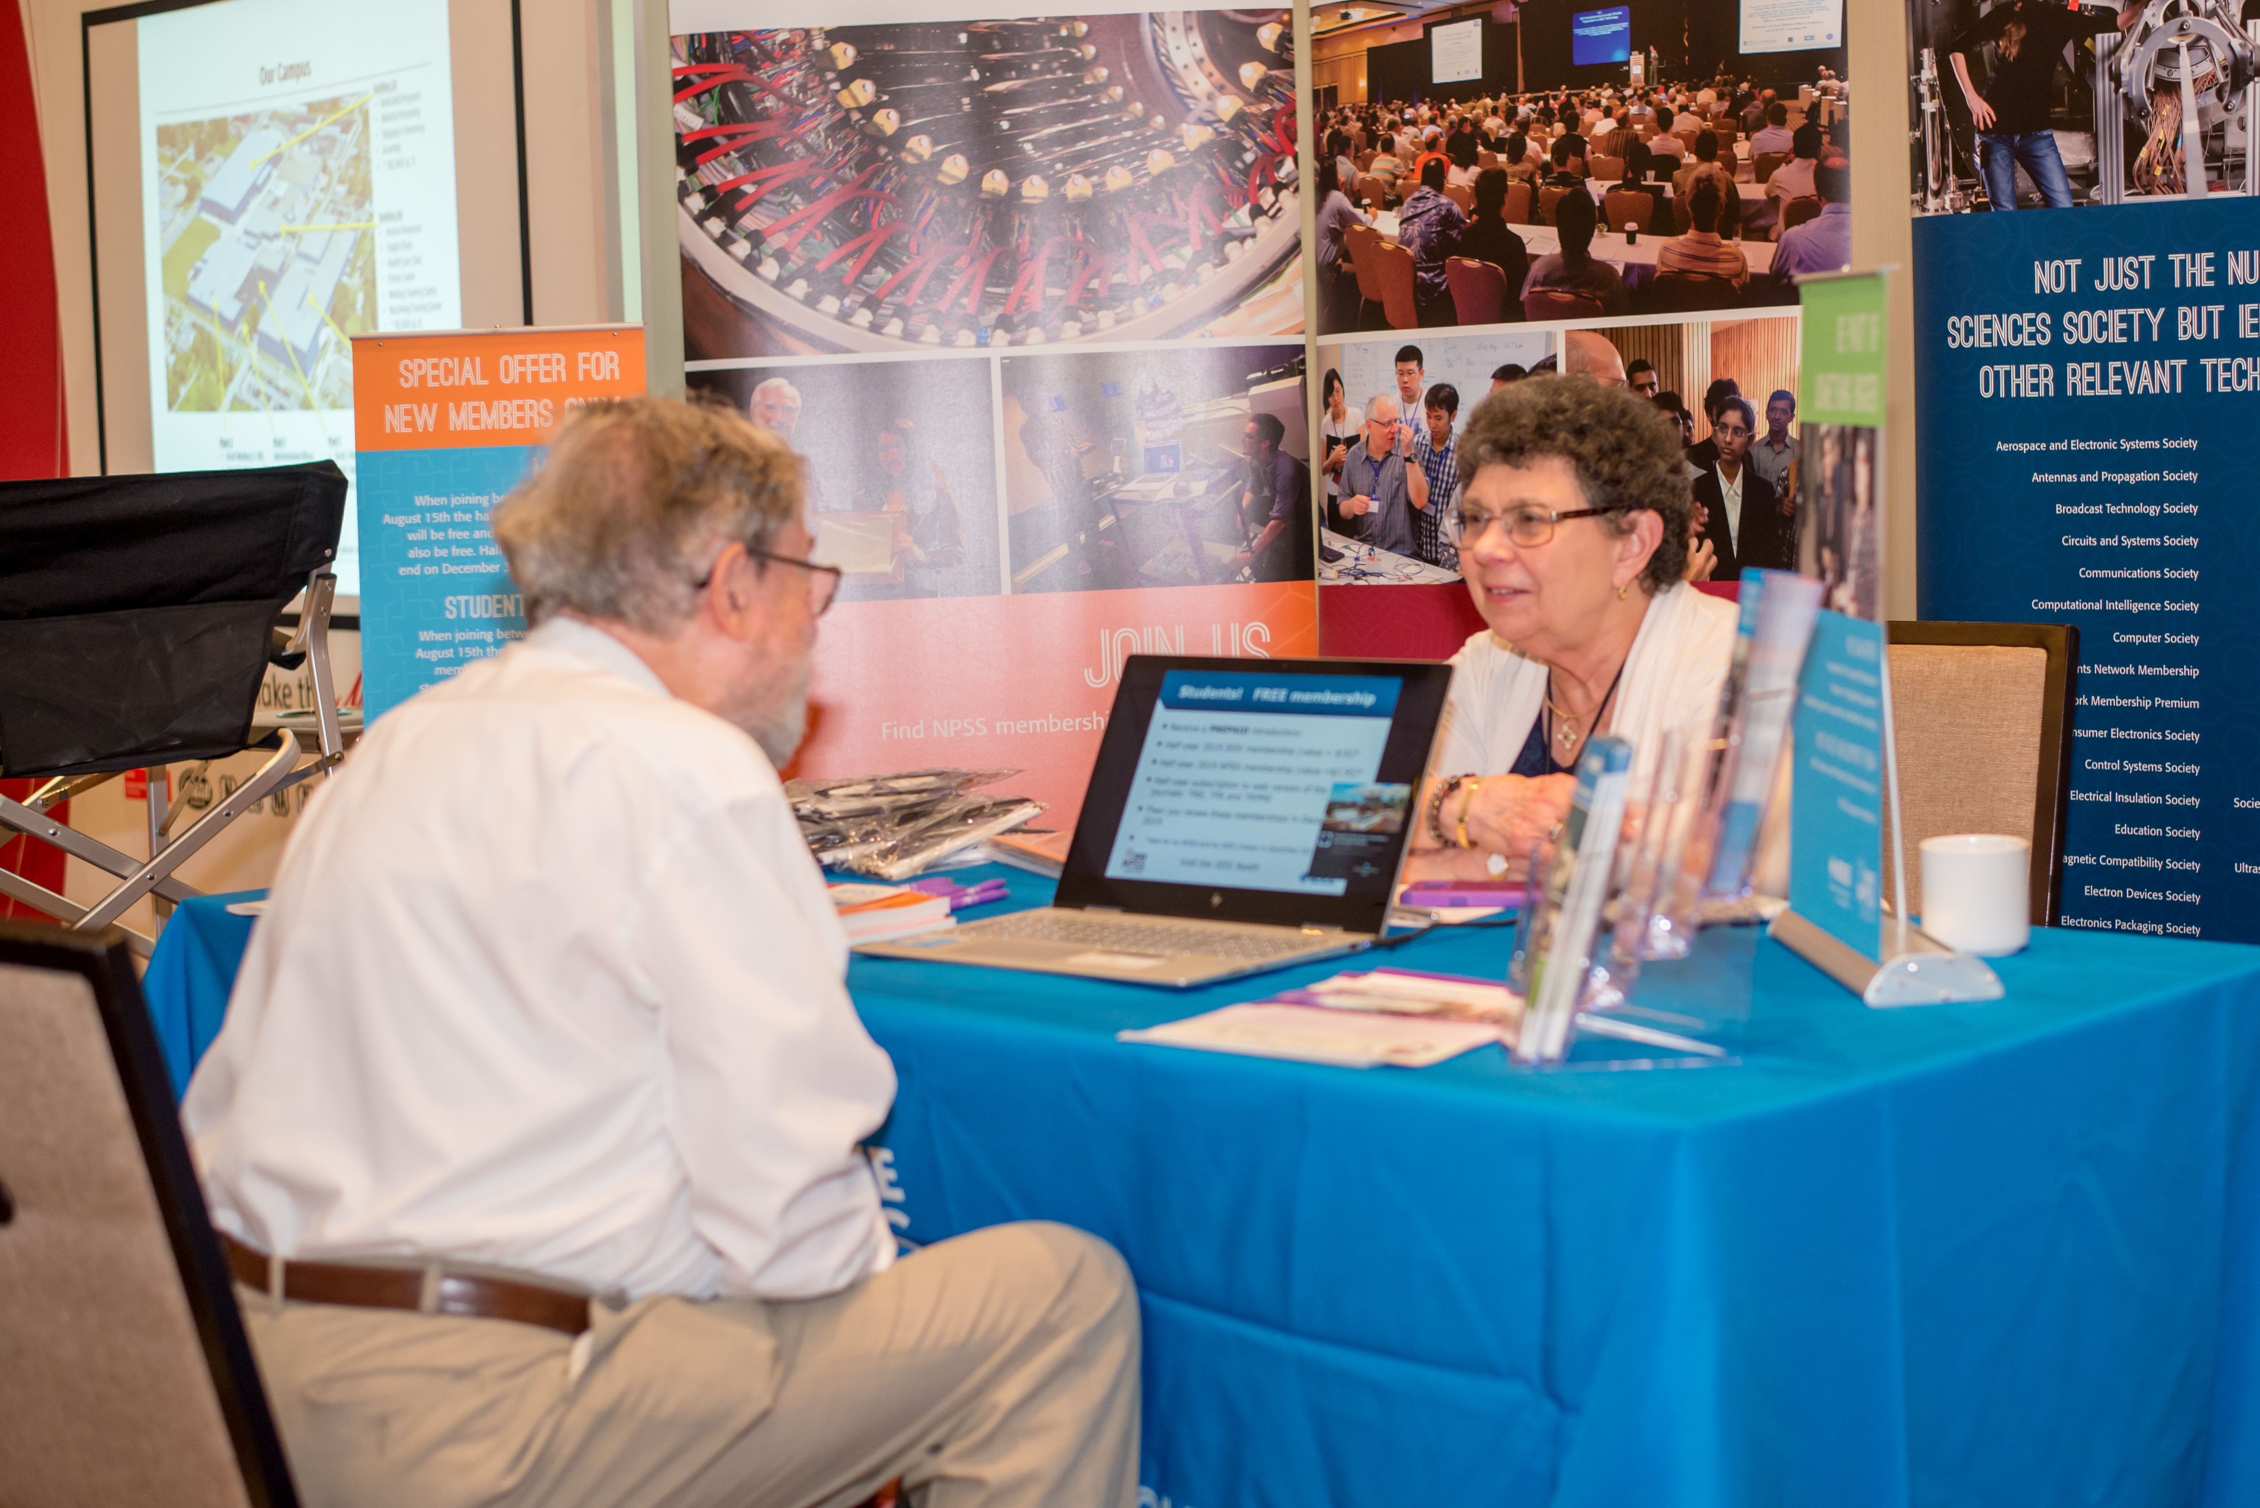
Where do I get more information: membership desk!

Slide 29
Why am I part of IEEE NPSS?
Reason #1: Support the Society
I believe what IEEE does is great and I want this to continue
My membership supports the society, no society without members
For the same reason I’m a member of Greenpeace and Wikipedia

Slide 30
Why am I part of IEEE NPSS?
Reason #2: Networking
I met people at IEEE conferences which influenced my career
I learned things I would not know without IEEE organized conferences and publications
Many people I met are now good friends

Slide 31
Why am I part of IEEE NPSS?
Reason #3: Excellence
Some online courses and webinars are only offered for IEEE members
Being IEEE Senior Member recognized my achievements and helped my career
Interdisciplinarity: Learned from other fields for my daily work at conferences

Slide 32
Why am I part of IEEE NPSS?
Reason #4: Volunteering
Through IEEE volunteering, I got a vary valuable free management education
Volunteering sharpened my scientific and social skills
  Review work of others
  Manage small groups of people
  Help and support conference attendees
Volunteering feels great!

