Slide 1

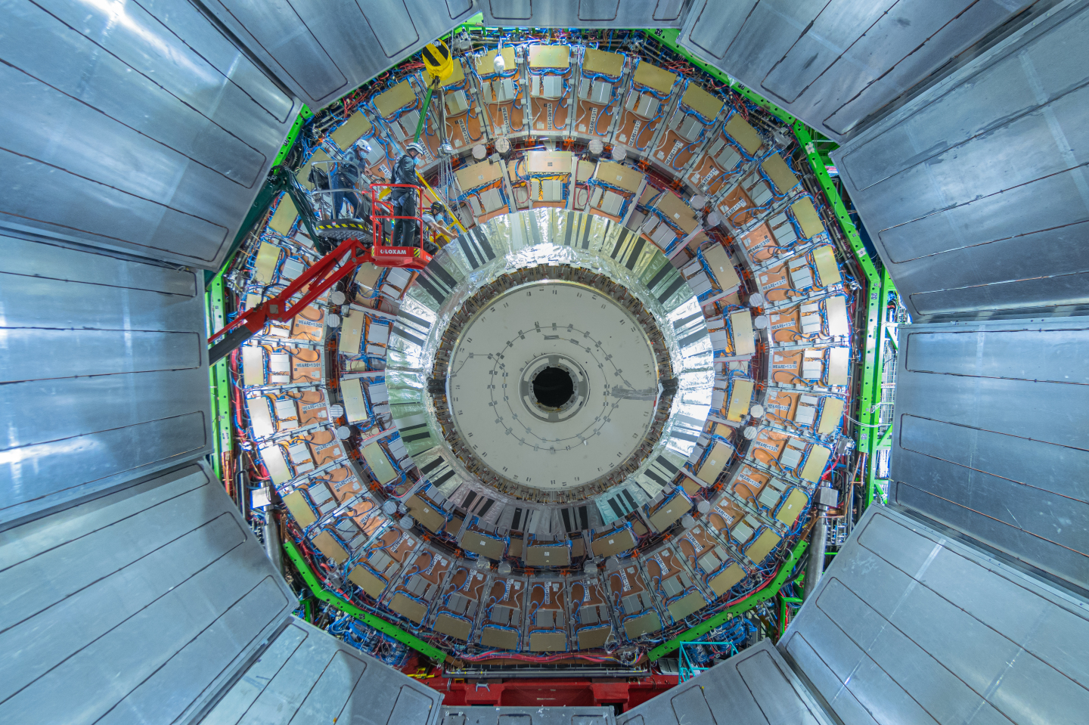
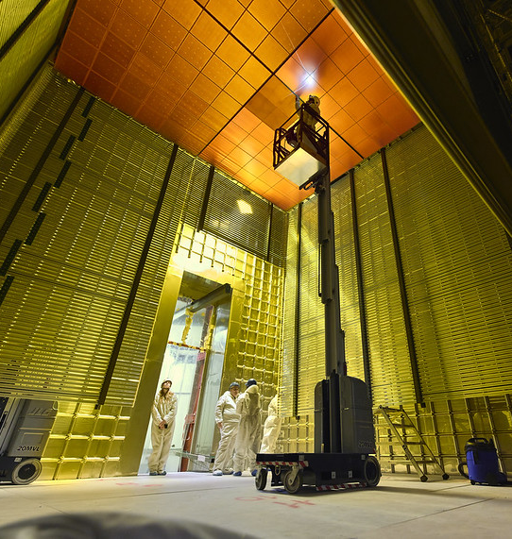
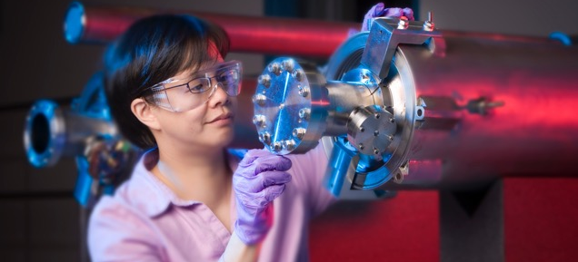
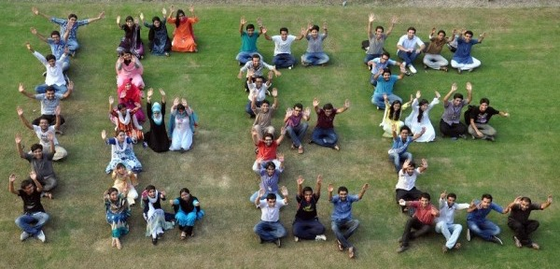
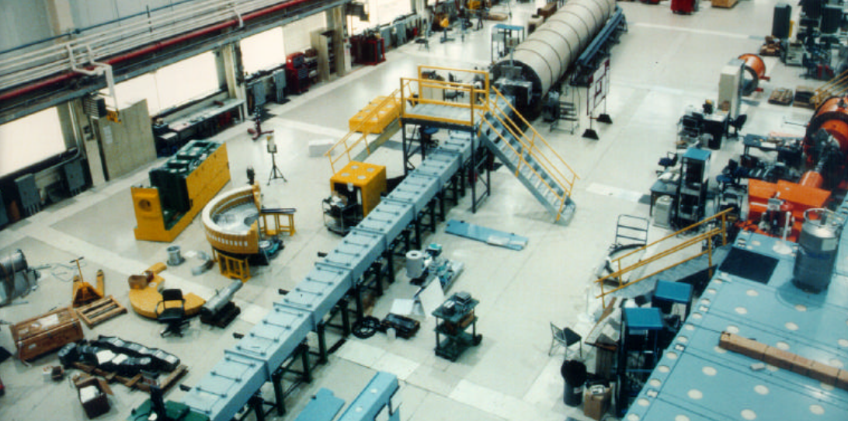
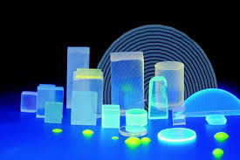
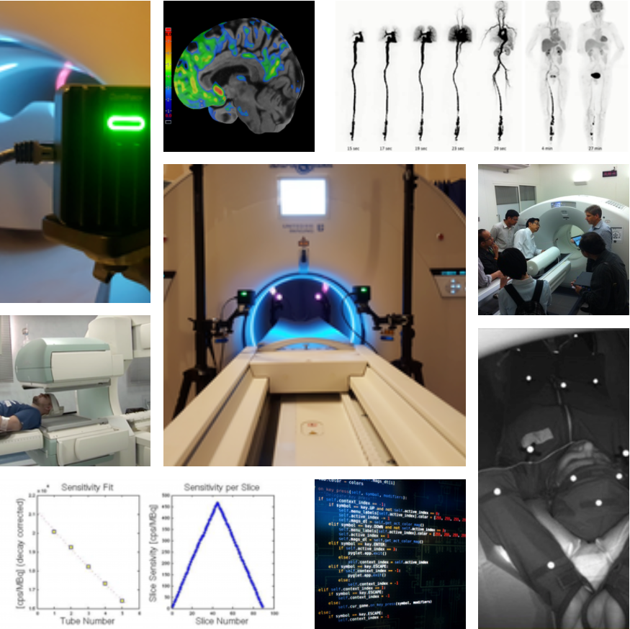
IEEE Nuclear & Plasma Sciences Society
Steve Meikle, President IEEE NPSS

Slide 2
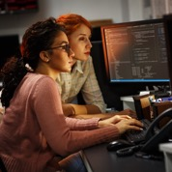

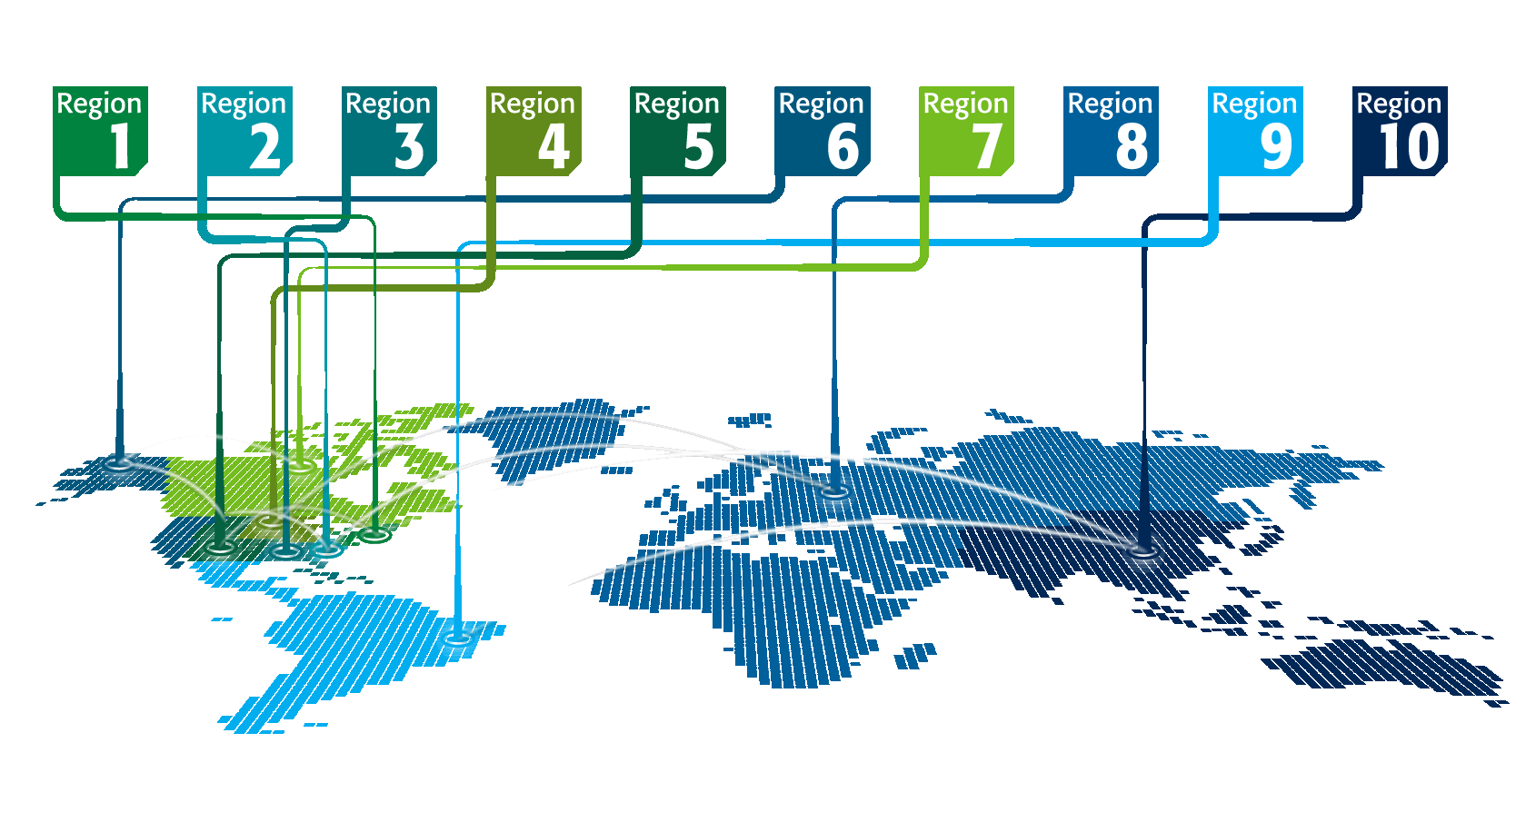

IEEE at a Glance
More than 409,000 members
in over 160 countries
39 Technical Societies and 7 Technical Councils
Publishes approximately 200 transactions, journals, and magazines
Over 5 million documents in
IEEE Xplore® with >15 million downloads/month
Sponsors more than 1,900 conferences in 96 countries each year

Slide 3
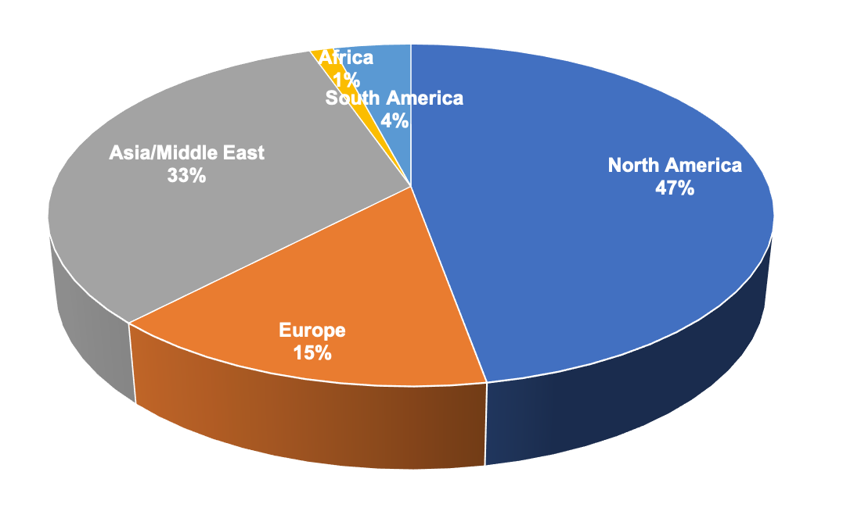
IEEE Nuclear and Plasma Sciences Society (NPSS)
Scope:
Computer Applications in Nuclear and Plasma Science
Fusion Technology
Nuclear Medical and Imaging Sciences
Particle Accelerator and Technology
Plasma Science and Applications
Pulsed Power Science and Technology
Radiation Effects
Radiation Instrumentation
Computer Applications in Nuclear and Plasma Science
Fusion Technology
Nuclear Medical and Imaging Sciences
Particle Accelerator and Technology
Plasma Science and Applications
Pulsed Power Science and Technology
Radiation Effects
Radiation Instrumentation
~3,000 members in 80 countries

Slide 4
What does NPSS do for you?
Organize and financially sponsor this conference
Sponsor additional events at the conference:
  Women in Engineering Luncheon (Today, 12:45-2:15pm, Green 2)
Provide (via generous donations to NPSS):
  186 student grants at NSS/MIC 2022 ($345 each)
  8 Jordanov travel grants ($1500 each)
  5 child care assistance grants ($400 each)
Give awards at all career levels
Fund initiatives (1-3 year projects) within the strategic mission of NPSS

Slide 5
NMISC Initiatives Sub-committee
Initiatives are NPSS sponsored projects to support the mission of the IEEE and ideally to positively impact your individual technical society
Current members of the Nuclear Medical and Imaging Sciences Council (NMISC) Initiatives Sub-committee are:
  Robert Miyaoka (chair)
  Dimitra Darambara
  Antonio Gonzalez
  Mercedes Rodriguez and
  Youngho Seo
IEEE Mission Statement
IEEE’s core purpose is to foster technological innovation and excellence for the benefit of humanity

Slide 6
Proposed NMISC Initiative: Instrumentation Hardware Library
We are seeking interested partners for creating a hardware library of equipment and supplies for nuclear medical instrumentation
  Examples: photodetectors, scintillators, detector modules, electronics, etc.
  Concept is being developed as an initiative to put forward to AdCom for funding
Equipment would be available for loan to research groups and NPSS Schools
Interested in participating or proposing another IEEE NPSS Initiative? Contact:
  Robert Miyaoka (rmiyaoka@uw.edu)
  Antonio Gonzalez (agonzalez@i3m.upv.es) or
  Andrew Goertzen (andrew.goertzen@umanitoba.ca)

Slide 7


Should I become an IEEE member?
Yes!
Go and talk to one, they are easily recognisable …
IEEE/NPSS Member
Non Member

Slide 8
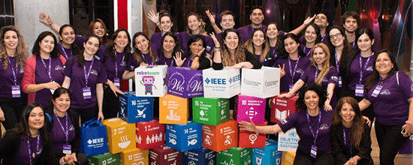

1. Networking Opportunities
Make friends and collaborations
Expand your professional network
WIE leadership summits
WIE Youtube channel

Slide 9
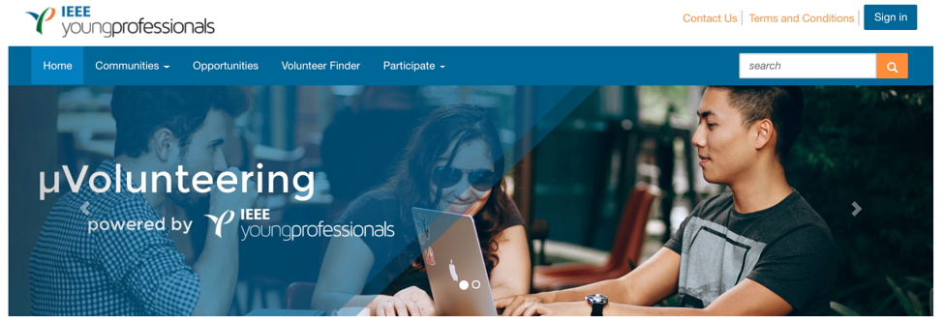
2. Volunteering Opportunities
Conference abstract reviewing
Journal article reviewing
Committee roles (NMISC, RISC, NPSS AdCom)
Conference organisation roles
http://uv.ieee.org

Slide 10
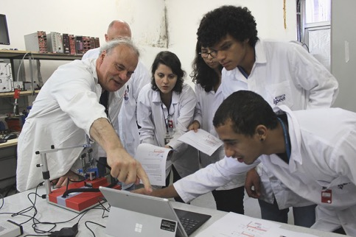
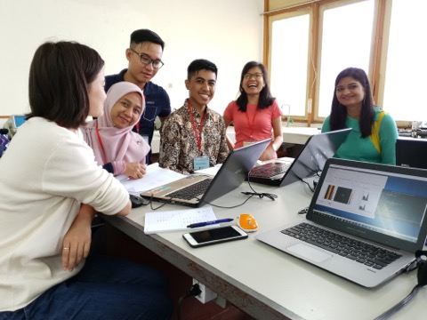
3. Develop your Leadership & Teaching Skills
Organise and teach a short course
Organise and teach a regional workshop
Nominate for a committee role on NMISC, RISC or NPSS AdCom

Slide 11
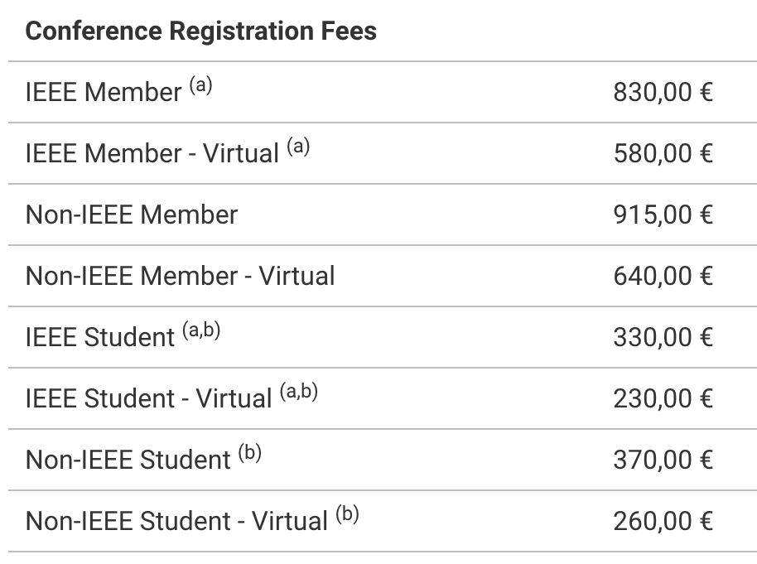
4. Save $$$

Slide 12
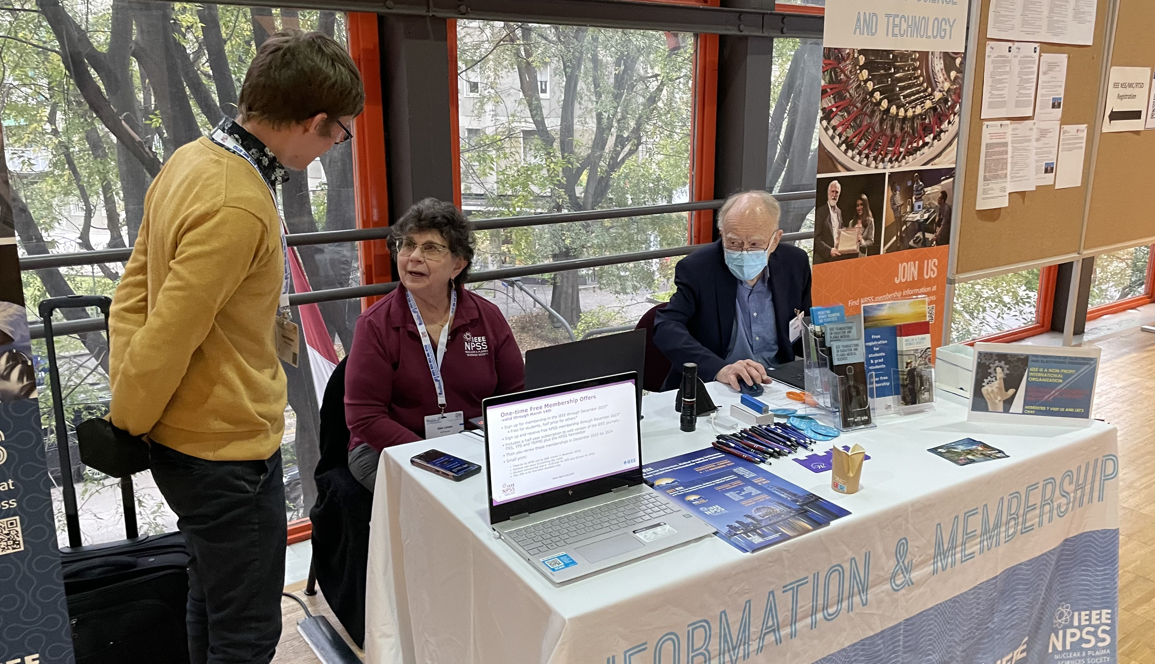
Visit the Membership Desk
Students: Free membership for this year and 2023
Others: 50% membership discount for this year and 2023
Be this guy!
… not this guy!

